Slide 1
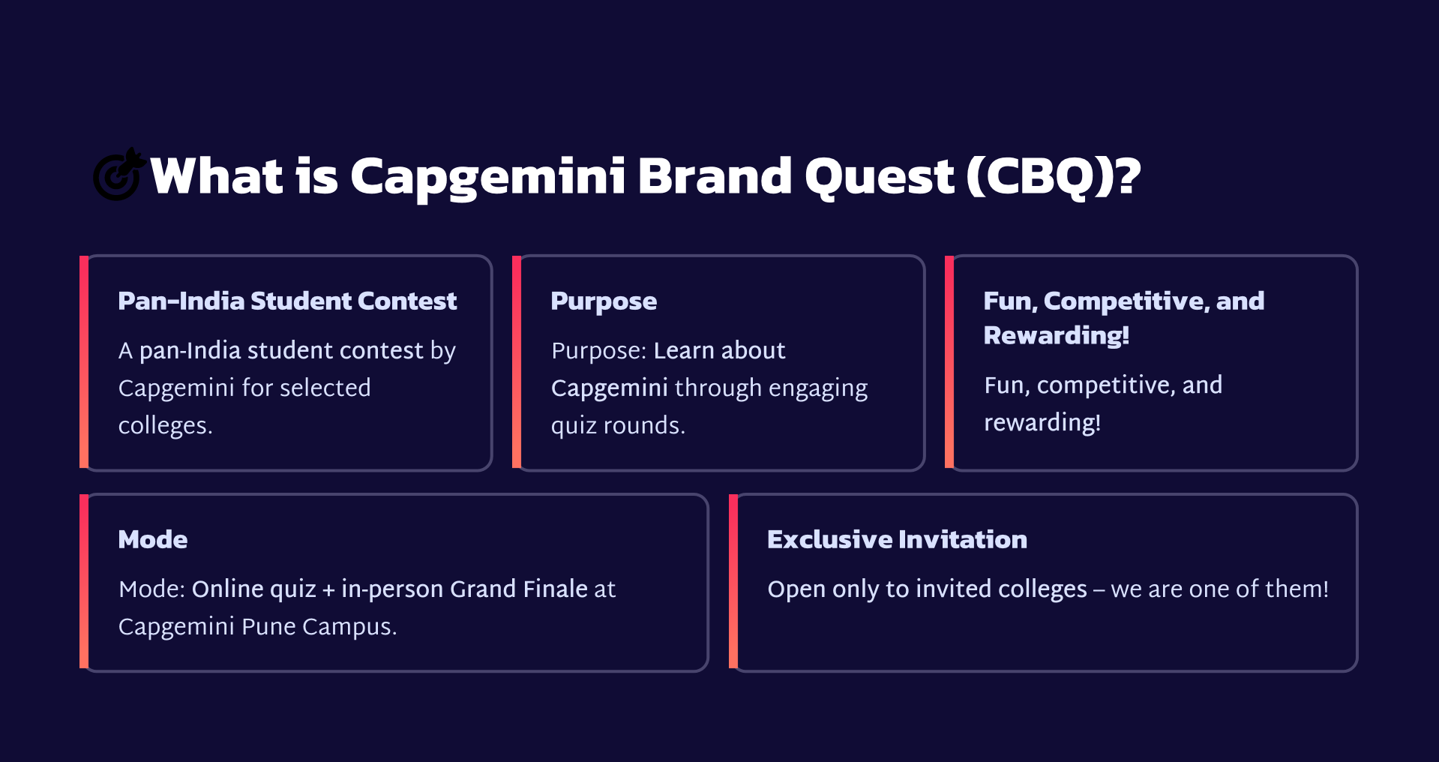

Slide 2
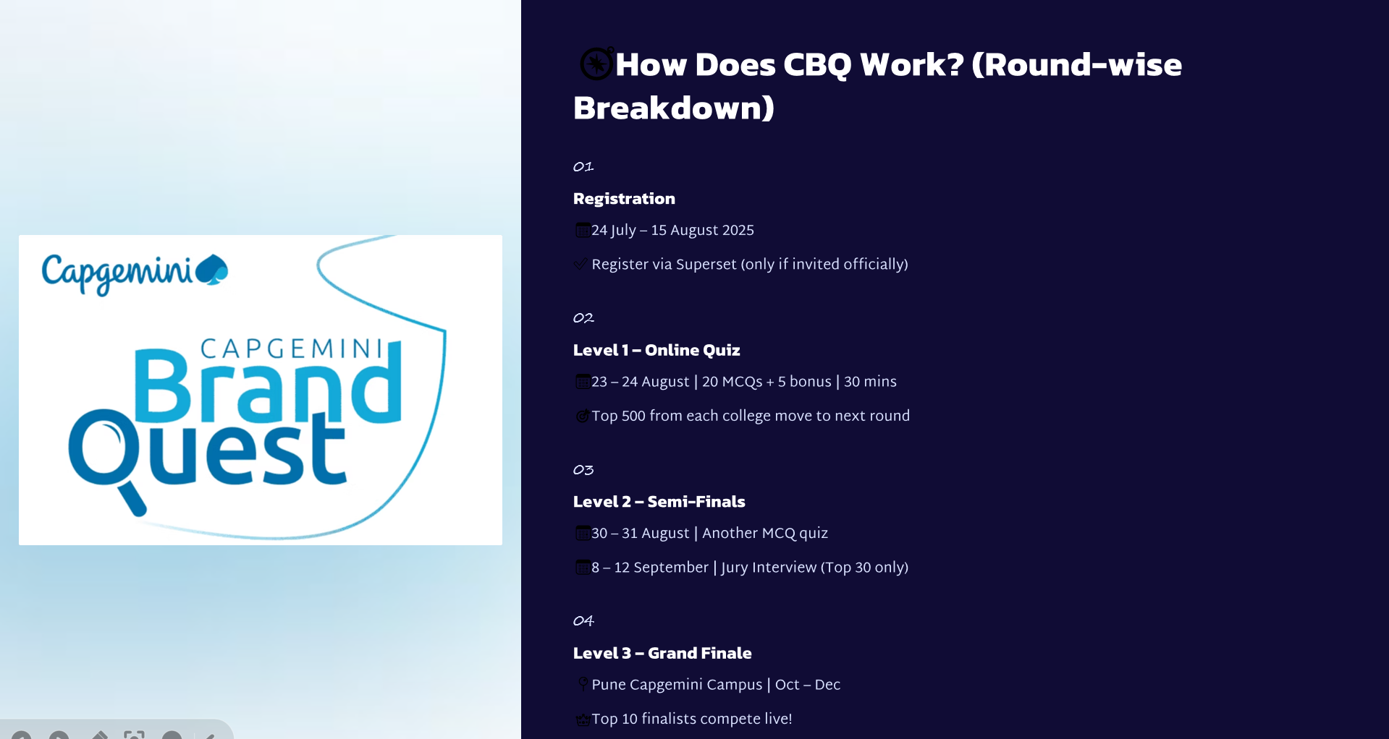
📅
✅ Register via Superset (only if invited officially)
📅 23 – 24 August | 20 MCQs + 5 bonus | 30 mins
🎯 Top 500 from each college move to next round
📅 30 – 31 August | Another MCQ quiz
📅 8 – 12 September | Jury Interview (Top 30 only)
📍 Pune Capgemini Campus | Oct – Dec
👑 Top 10 finalists compete live!

Slide 3
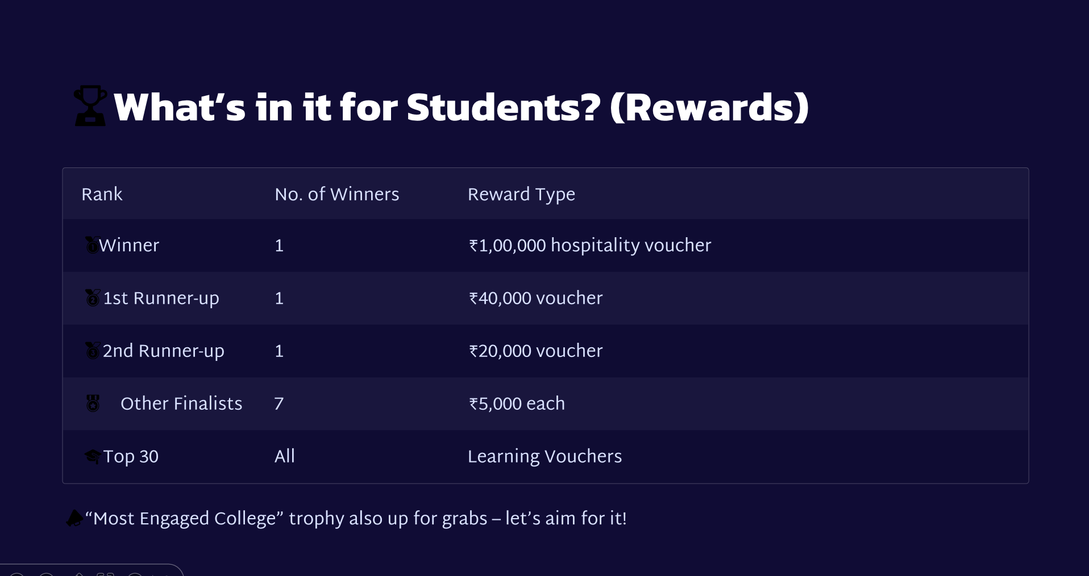

Slide 4
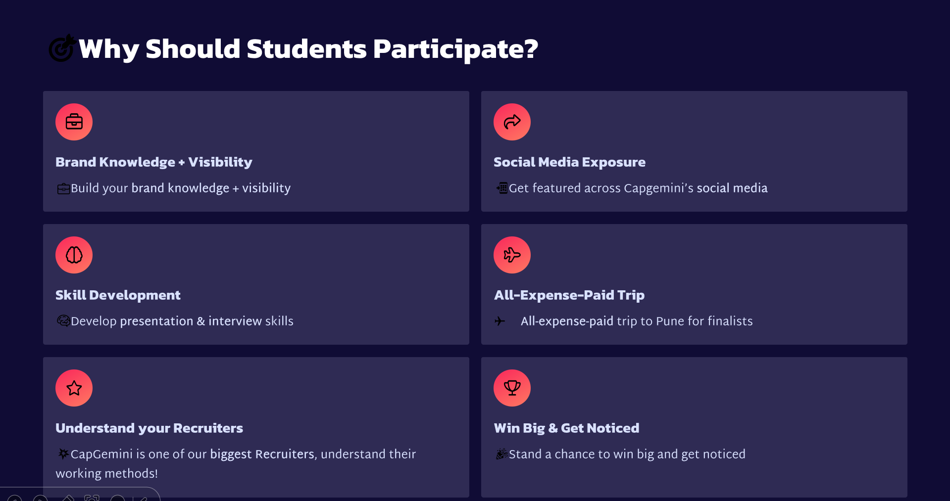

Slide 5
